Slide 1
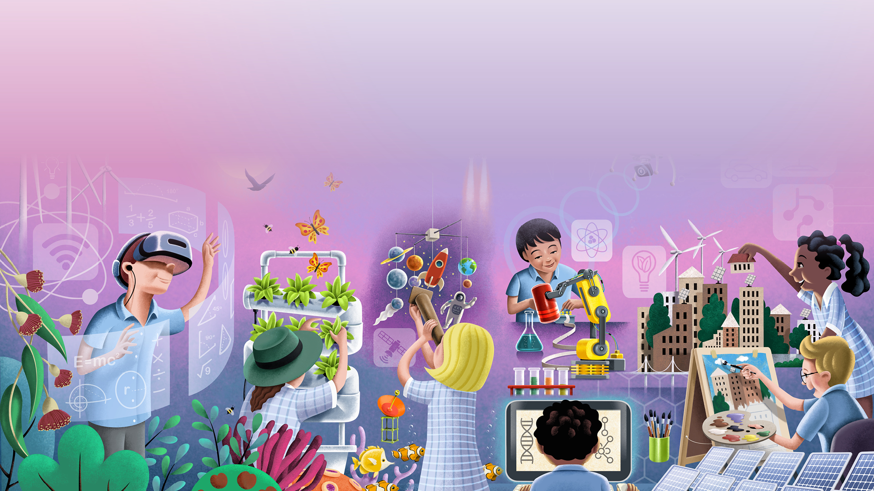


Age of the Machines. Interactive Slideshow

Slide 2


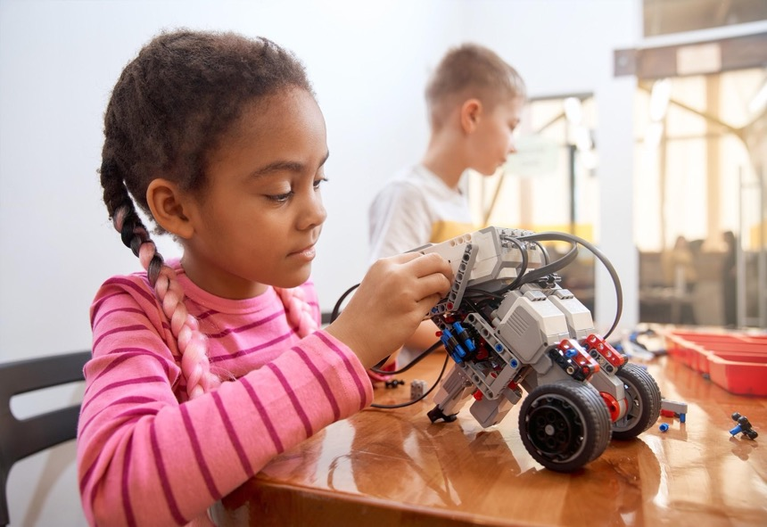
Who is this slideshow for?
This READ ALOUD Interactive Slideshow is for primary classes taking part in Australia Post Stamp Collecting Month 2021. It introduces Age of the machine! unit, one of three innovation themes of this year’s Full STEAM Ahead! program.
The slideshow introduces students to robotics, artificial intelligence and much more. It features background information, quizzes and thought-provoking discussion questions intended to extend your students’ thinking about technology and STEAM-learning.
Teachers should read through and discuss this slideshow with their class. Some of the topics discussed raise ethical issues. Teachers should use their discretion when introducing some of these themes.
The content in this slideshow is linked to the Australian Curriculum. For more detail, please see the Australia Post Stamp Collecting Month 2021 Teacher Guides.
The Teacher Guides provide a range of complementary activities and investigations.
Artificial Intelligence, robots, cyborgs and more. Let’s use our amazing new tools
to lead more efficient & connected lives.

Slide 3

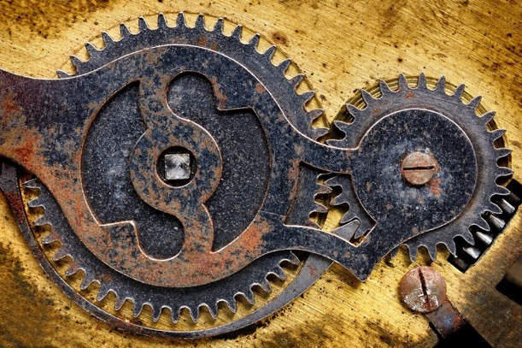
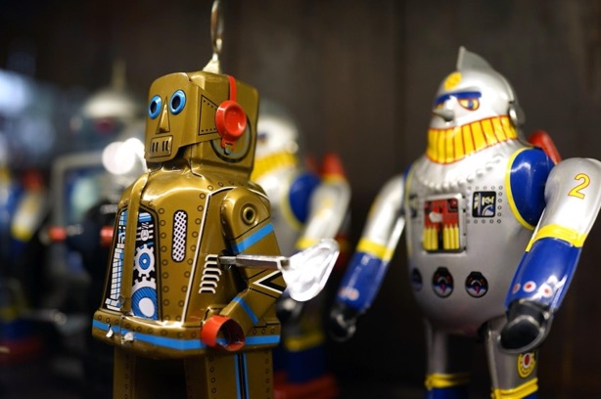
An extremely brief history of robots
Who has seen, or heard of, the Star Wars movies, cartoons and TV shows?
The Star Wars productions feature lots of robots, including the famous R2-D2 and C-3PO, and the new favourite, BB-8.
(Google some images of these robots with your teacher.)
Stories and artworks from ancient Greece and ancient China suggest that people have been fascinated by robots for a very long time.
Leonardo da Vinci, a great thinker who lived in Italy over 500 years ago, made detailed designs for a robot knight and a robot lion. In recent years, Leonardo’s designs have been built and have wowed audiences around the world.
But we have only been using electricity as a power source for around 150 years. It was only after we learned to use electricity that robots started to become a reality.

Slide 4
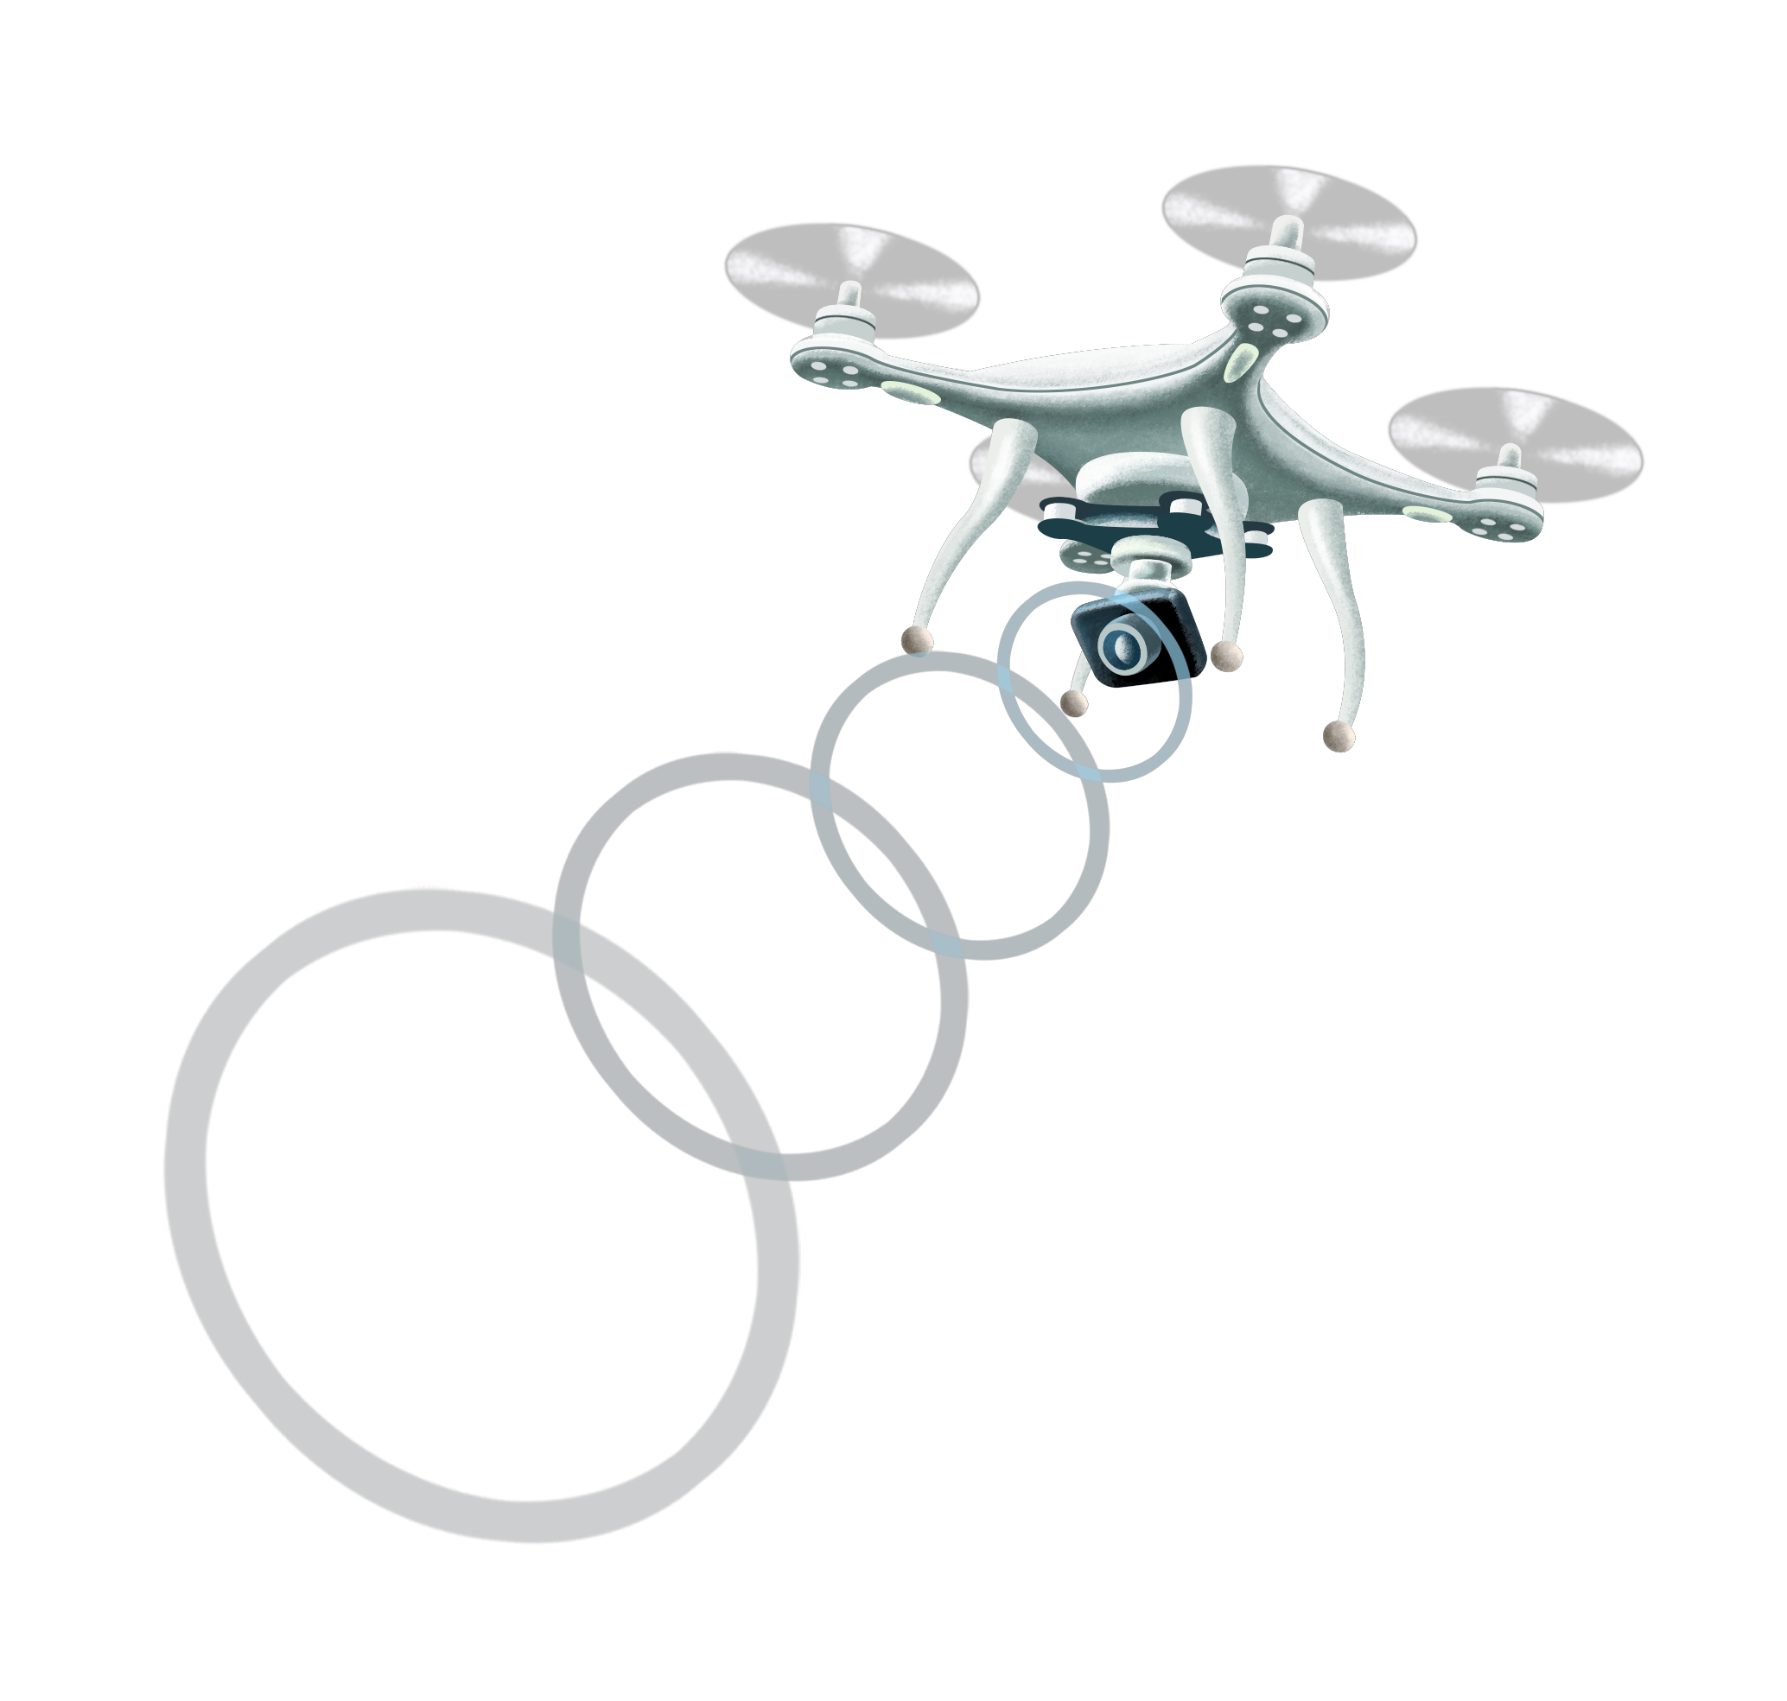
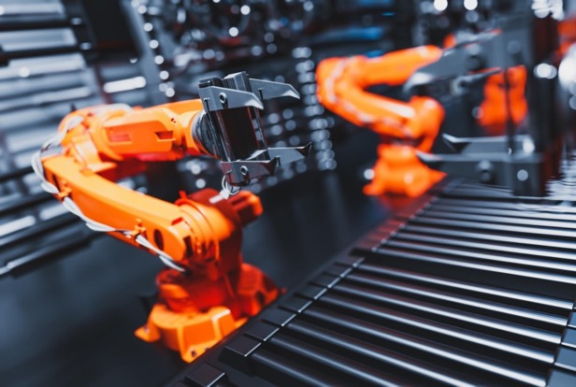
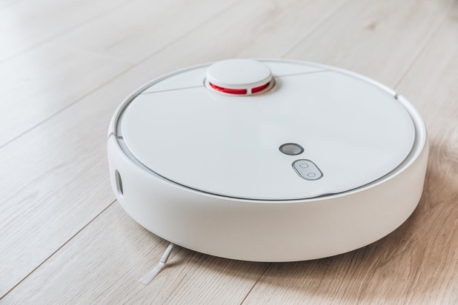
Conversation starter!
Stop and think. What is a robot?
Is a robot just any machine that helps us?
Do robots have to look like us?
When they look like us, we call them androids or humanoids.
Does a robot have to think for itself or can it just follow our instructions?
Partner Prattle!
Discuss your ideas with a partner, then share them with the class.

Slide 5


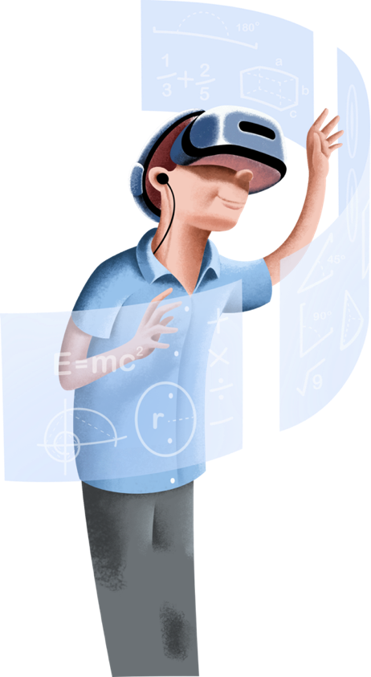
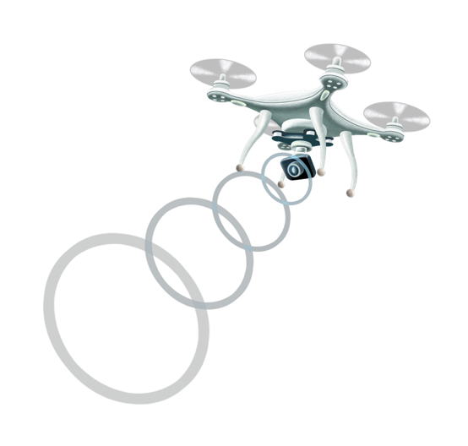
Virtual reality
Have you heard of the phrase “virtual reality” or VR? Perhaps you have used
VR in computer games.
VR is a computer-created environment users can enter using a special headset. VR environments can appear very real. One purpose of VR is for users to experience something before they experience it in the outside world.
Some of the ways VR is currently used include:
Computer games
Medicine, for example, for practicing delicate operations
Education, so students can experience different times and places, and learn different skills
Architecture, so people can experience what buildings will look like before they are constructed.
Can you think of any ways VR could be used at your school? How would this help?

Slide 6
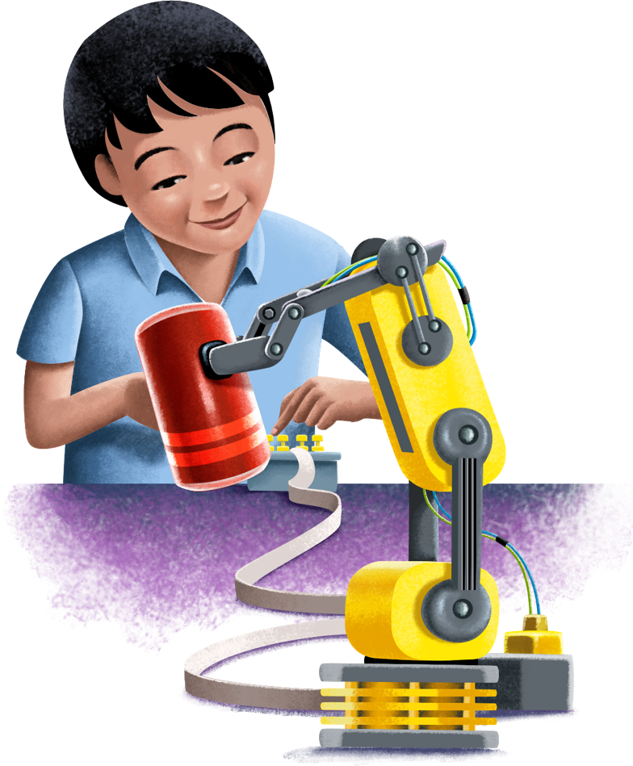
Robots, now!
Have you seen robots on TV or on the internet?
What did they look like? What did they do?
Over the last 60 years or so, real robots have been used in factories to make products which we can buy. These robots don’t always look like people. They often just look like a huge metal arm with a big mechanical hand.
Robots are also being used by doctors to perform operations. They can perform extremely precise, delicate movements. They are not affected by movement from their own breathing, like human doctors.
Self-driving cars are a new type of robot. They use different onboard sensors to drive without a human at the controls. The main challenge for self-driving cars is that they can find it difficult to drive alongside humans who can drive very unpredictably.
If it was legal, would you ride in self-driving car now? Or would you wait a little while? Why?

Slide 7
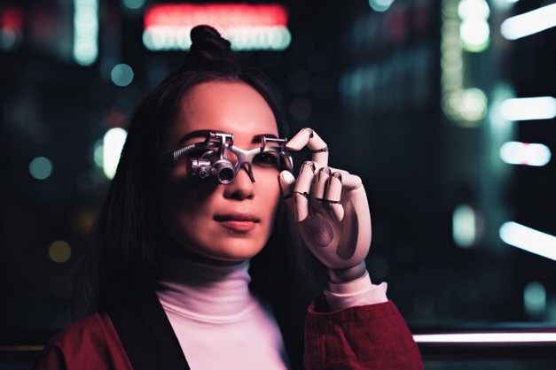
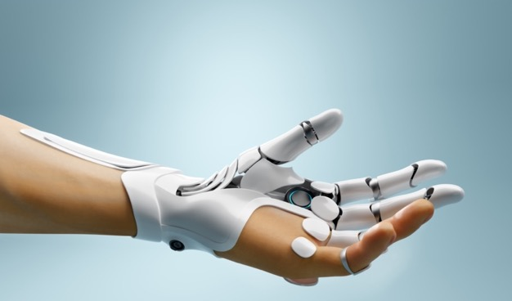
Cyborgs!
Have you seen robots on TV or on the internet?
Have you heard the word cyborg?
A cyborg is part-human and part-machine.
Neil Harbisson, a previously colour-blind man in Britain has an antenna implanted into his brain that allows him to see not only colour, but also infrared light and ultraviolet light. The British government even classifies Neil as a cyborg.
There are many ways technology could be built into our bodies. These include:
Wearing “exoskeletons” to make factory workers or soldiers stronger
Implanting miniature computers into our brains to access the internet, increase our memory, or connect to other people’s brains so we can solve problems together.
Does all this cyborg-talk “weird you out”? That’s normal.
Throughout history, when new technologies have been created, they have often made people feel funny. Our job, as a community, is to debate whether these changes are a good idea.

Slide 8
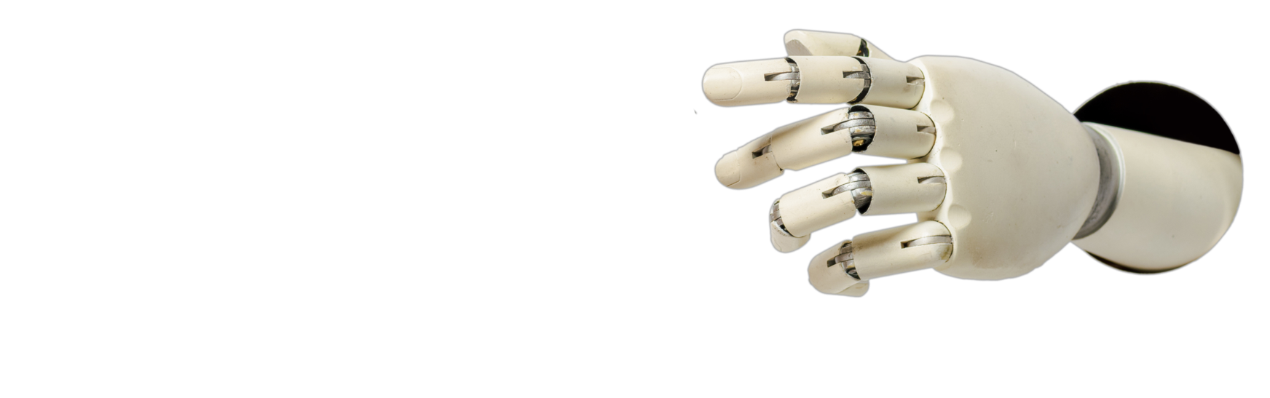
Conversation starter! 2
What technology would you most like to make part of your body?
Why?
How would this technology improve your life and the lives of others?
What challenges would this create for you or for your relationships with other people?
Partner Prattle!
Discuss your ideas with a partner, then share them with the class.

Slide 9
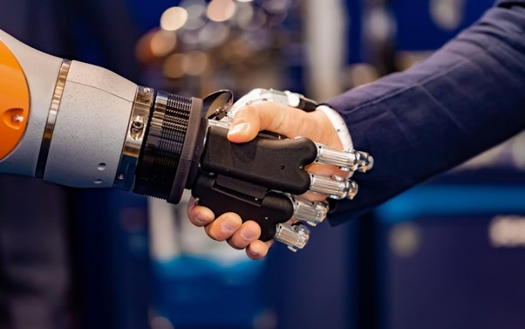
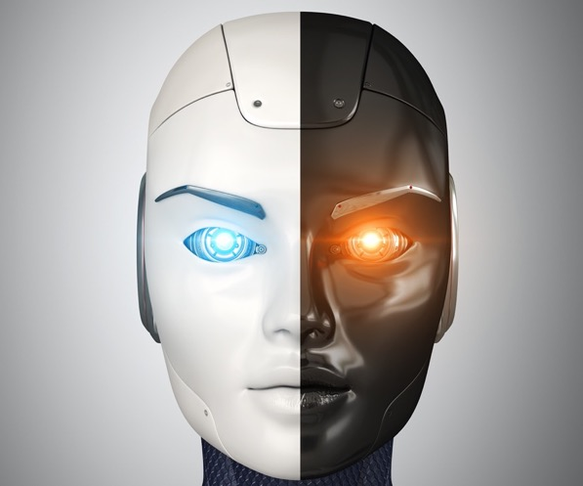
Artificial intelligence!
Have you heard of the phrase “Artificial Intelligence”?
Artificial Intelligence, or AI, is when computers and machines are able to think and learn like humans.
AI is an exciting new frontier in computing and technology. Once computers “learn” a skill, they are able to perform it much quicker than humans.
The two most powerful countries in the world, the U.S.A. and China, are planning to spend record amounts of money on AI over the next five years.
AI is used in:
Understanding large amounts of very complicated information
Understanding speech, which can vary a lot from person to person
Self-driving cars, to observe and react to the road
Playing complex strategic games, like Chess and Go
Some people think AI could change the world even more than electricity has over the last century.

Slide 10

Quick quiz!
Which skills and qualities do you think
computers using artificial intelligence
will be able to perform better than humans?
Empathy (caring)
Communicating with other humans
Writing and creating
Making up complicated plans and strategies
None of the above

Slide 11
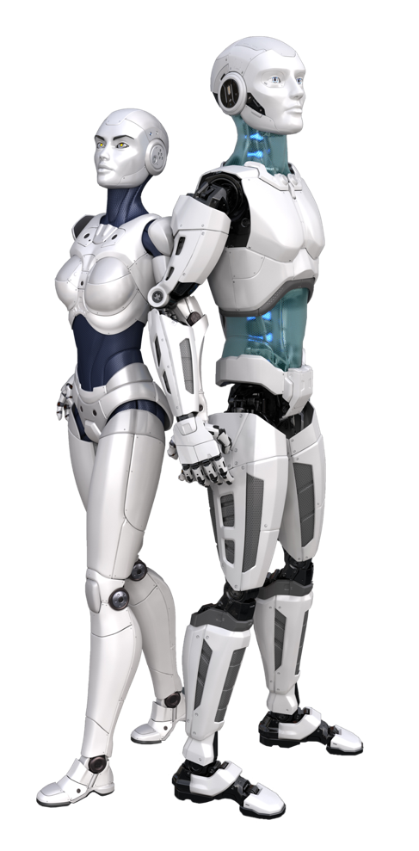

Answers!
e) None of the above.
Computers and robots might replace humans in many simple jobs. But most of the things humans are really good at, like caring, communicating and creating, will be extremely difficult for computers to master.
Your amazing human skills like COLLABORATION, CREATIVITY and CRITICAL THINKING will ensure YOU have a bright future at the centre of your community.
Are you ready to CREATE an awesome life for yourself in the Age of the Machine?

Slide 12

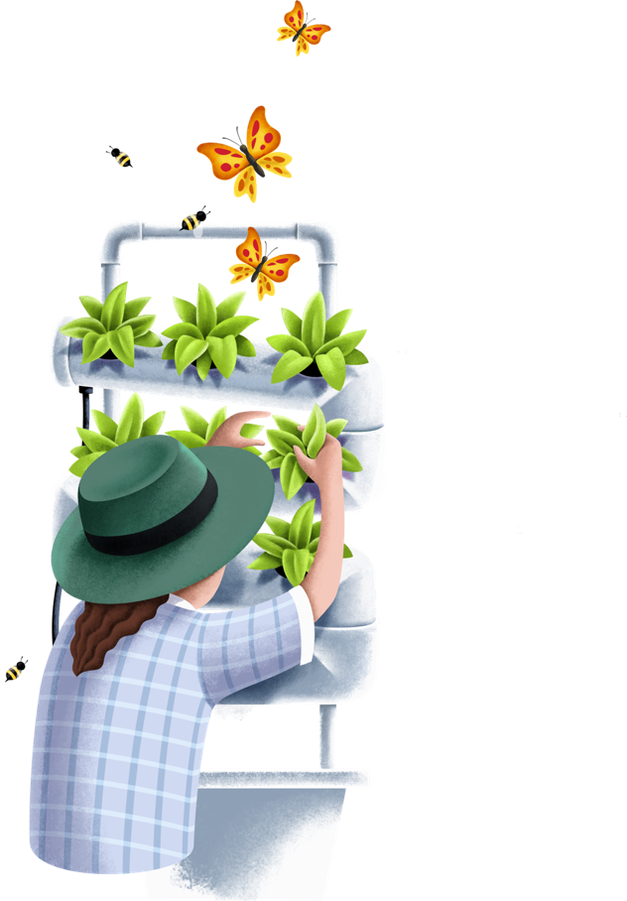




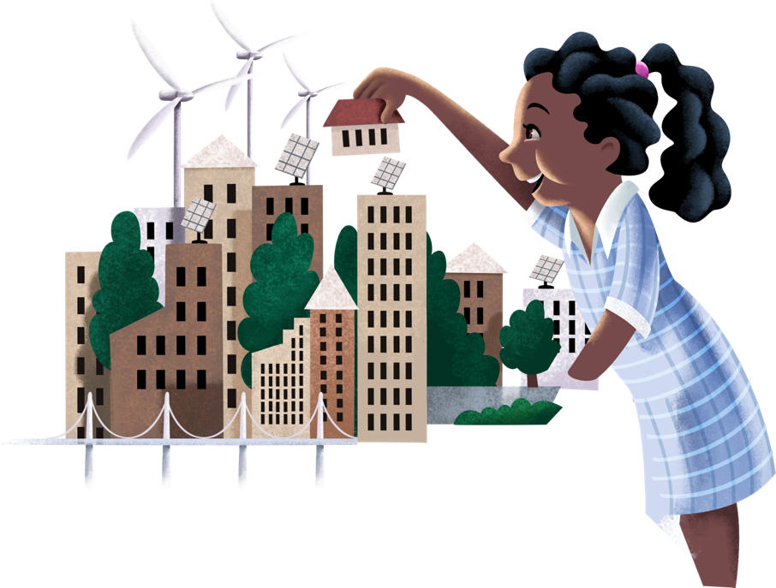
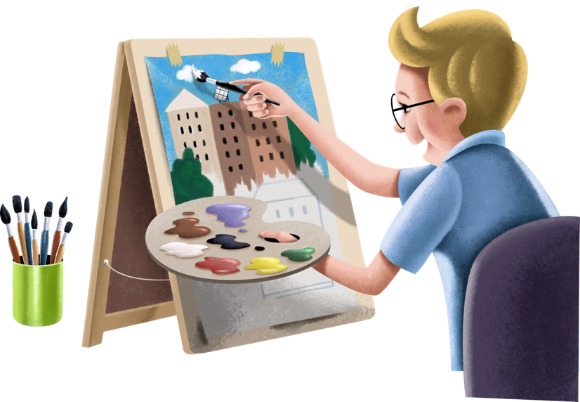
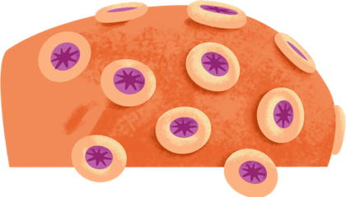

Next Steps
The ideas in this interactive slideshow are developed in the Stamp Collecting Month 2021 Teacher Activity Guides.
Download the Teacher Guides for follow-up student activities and investigations.
Full STEAM Ahead!

